Slide 1

National Cyberculture Program
BRAMA School CyberCulture
Decision-grade instrument for launch, funding, and controlled scaling of child protection in digital environments at national policy level.
System logic: Learning -> Awareness -> Behavior -> Participation -> Protection
Rollout format: 50-school pilot, scaling to 1000 schools, control via KPI, SLA, and Human-in-the-loop decision audit.
Decision contour
1. Educational contour School
2. AI BRAMA Agent
3. Cyber Virtual Police
4. Governance and audit
5. KPI + phases + budget
Real deployment environment in schools
rollout contour: school / teacher / family
240,000,000 UAH
18-month cycle budget
50 -> 1000
pilot-to-scale schools
3 phases
controlled rollout and governance
SLA
15 / 30 / 240 min
Menu
Next
Notes:
Transition: Fade. Build: title -> subtitle -> KPI cards.

Slide 2

BRAMA School CyberCulture
Problem
Digital risks escalate faster than current school response capacity.
Education gap
• no unified cyberculture curriculum standard;
• uneven teacher/parent readiness;
• fragmented learning content;
• no regular validation of digital behavior maturity.
Operational gap
• incidents are often detected after harm occurs;
• incomplete SOP response route in schools;
• delayed escalation in critical cases;
• uneven workload on responsible officers.
Indicators of risky behavior in digital channels
triggers: DM / phishing / manipulation / cyberbullying
Governance gap
• fragmented data for decision and reporting;
• difficult phase-by-phase funding justification;
• high-risk scaling without gate control.
heatmap: risk sources
SOP gap
governance lag
Menu
Back
Next
Notes:
Transition: Fade. Cards appear left-to-right.

Slide 3

BRAMA School CyberCulture
Context: Ukraine
A national preventive child cyber-protection system is required.
Student digital exposure to risky channels
Context factors
• increasing incident intensity in school-age groups;
• high exposure to manipulation, grooming, and phishing;
• need for an integrated education + AI + human decision model;
• critical need for early detection and regulated response.
R
S
K
bar chart: risk contours
SLA control
KPI trend
Menu
Back
Next
Notes:
Transition: Morph.

Slide 4

BRAMA School CyberCulture
Solution
BRAMA School CyberCulture as a unified prevention and response system.
Learning
Awareness
Behavior
Participation
Synchronization of learning, AI analysis, and human decision
Protection
operations: signal -> verification -> action
Decision key message
• education contour forms baseline cyberculture for all audiences;
• AI BRAMA Agent scales speed and quality of risk handling;
• human-in-the-loop guarantees legality and trust;
• governance receives monthly evidence for scaling decisions.
Menu
Back
Next
Notes:
Transition: Fade.

Slide 5

BRAMA School CyberCulture
Key Features
The system is built on four interconnected capability blocks.
Educational contour School
• risk-based modules;
• teacher package;
• school certification.
AI BRAMA Agent
• AI tutor and Q&A;
• AI teacher assistant;
• AI process operator.
Cyber Virtual Police
• role model Junior/Officer/Senior;
• SOP response chain;
• moderation and escalation.
Governance
• RBAC and logging;
• KPI discipline;
• management audit.
Menu
Back
Next
Notes:
Transition: Fade.

Slide 6

BRAMA School CyberCulture
How it Works
Flow diagram: student -> risk -> AI Agent -> Officer -> Senior -> report -> action.
Student
Risk
AI Agent
(signal)
Officer
(SOP)
Senior
(decision)
Report
& correction
Process outcome
• each case ends with controlled decision and evidence trail;
• learning correction reduces repeat-risk exposure;
• governance receives measurable KPI outputs.
Menu
Back
Next
Notes:
Transition: Morph.

Slide 7

BRAMA School CyberCulture
scheme: event -> signal -> human -> action
channels: API / dashboard / SOP
control: RBAC / audit / SLA
Architecture
Interactive map of contours and data flows.
School
AI Agent
S
AI
Cross-contour interaction in controlled process mode
BRAMA
Core
Cyber Virtual Police
Governance
C
G
Integrations
Roblox/Fortnite/Minecraft
I
Menu
Back
Next
Notes:
Transition: Fade.

Slide 8
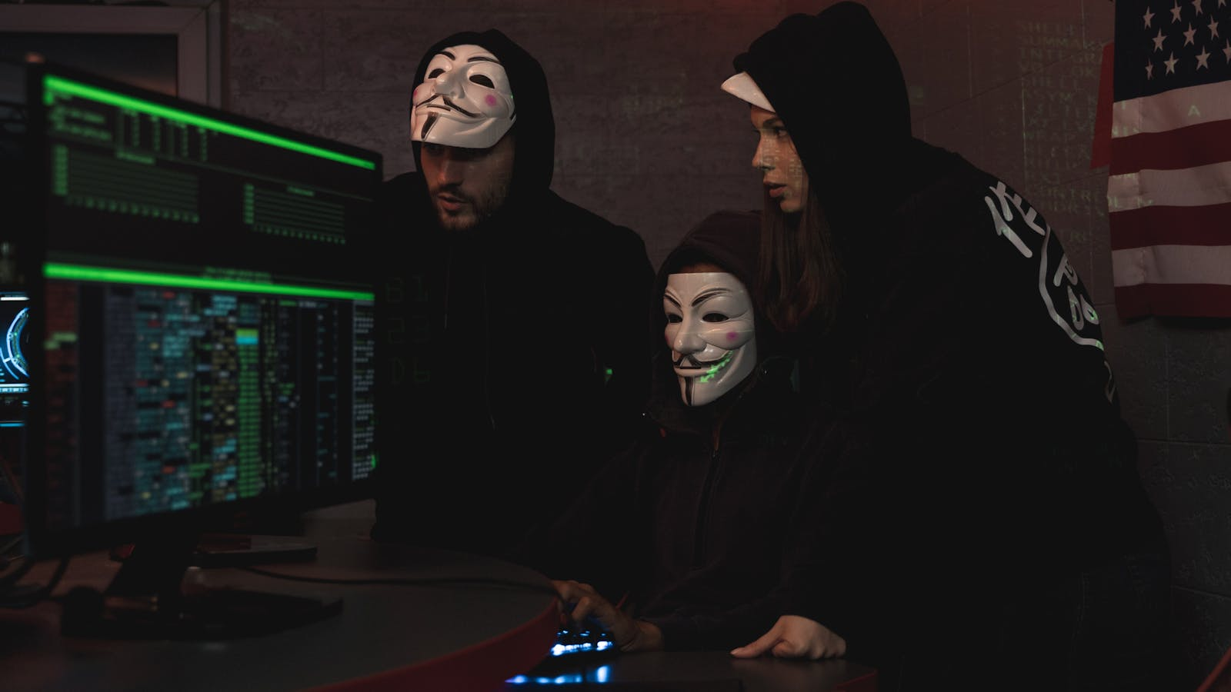
BRAMA School CyberCulture
AI Component
AI BRAMA Agent strengthens education and operations without autonomous final decisions.
AI BRAMA Agent roles
• AI tutor: micro-lessons and Q&A;
• AI teacher assistant: tests/quizzes/materials;
• AI operator: intake, routing, auto-reports.
Guardian Pipeline
• detect -> score -> route -> human confirm;
• risks: grooming / bullying / manipulations;
• control: SLA + audit trail.
Human-in-the-loop
• AI does not make final decisions; authorized human validates action and closure.
Menu
Back
Next
Notes:
Transition: Fade.

Slide 9

BRAMA School CyberCulture
Use Cases
Ten scenario directions with standardized response logic.
Scenarios 01-05
• 01 Grooming in game chat
• 02 Cyberbullying in school community
• 03 Phishing link in messenger
• 04 Fake contest manipulation
• 05 PII extraction attempt
Scenarios 06-10
• 06 Toxic escalation in voice chat
• 07 Harmful content spread
• 08 Pseudo-recruitment to closed channel
• 09 Social engineering via known contact
• 10 Repeat risk after closure
Case logic template
• context -> trigger -> roles -> in/out data -> algorithm -> closure criterion.
Open deep demo
Menu
Back
Next
Notes:
Transition: Fade. Clickable drilldown button to appendix.

Slide 10

BRAMA School CyberCulture
Target Audience
Value is formalized for each stakeholder group.
Students
• risk recognition;
• behavioral readiness;
• response algorithm in cases.
Parents
• family cyberculture modules;
• response templates;
• safety without over-surveillance.
Teachers and schools
• ready lesson + test package;
• school cabinet and statistics;
• BRAMA certification.
Government and partners
• consolidated KPI contour;
• transparent reporting;
• controlled scaling.
Menu
Back
Next
Notes:
Transition: Fade.

Slide 11

BRAMA School CyberCulture
Impact
Outcome is measured through KPI dynamics.
Key impact
• incident reduction;
• higher cyberculture proficiency;
• faster response time;
• repeat-risk suppression.
Menu
Back
Next
Notes:
Transition: Morph.

Slide 12
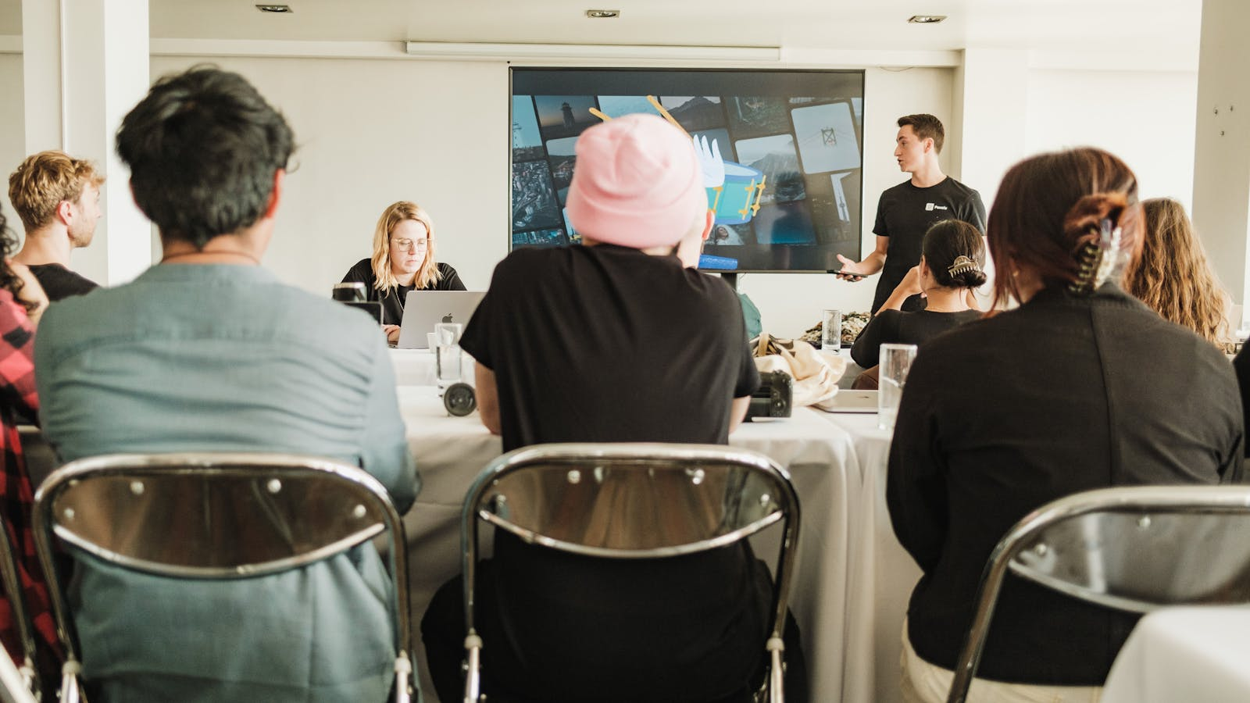
BRAMA School CyberCulture
Metrics / Analytics
Pseudo-dashboard for operational execution control.
1000+
target schools
85%
module completion
<30 хв
Officer first response
65%
AI process automation
Pseudo dashboard
• SLA compliance: 87%;
• education plan execution: 74%;
• human decision validation: 100%;
• repeat-risk trend: -41%.
Dashboard drilldown
Menu
Back
Next
Notes:
Transition: Fade.

Slide 13

BRAMA School CyberCulture
Roadmap
Three implementation phases with gate criteria.
Phase 1 (0-6 mo)
• education launch and baseline;
• AI tutor launch;
• gate: cycle stability.
Phase 2 (7-12 mo)
• CVP operational launch;
• full SOP route;
• gate: target SLA.
Phase 3 (13-18 mo)
• regional scaling;
• cost optimization;
• gate: next-cycle readiness.
Menu
Back
Next
Notes:
Transition: Zoom.

Slide 14

BRAMA School CyberCulture
Investment Proposal
Scaling finance model with transparent funding structure.
Financial frame
• 240,000,000 UAH / 18 months / 1,000 schools;
• proportional cost drop for smaller scale;
• monthly CAPEX/OPEX governance.
Investor/donor logic
• why now: escalating threat environment;
• effect: controlled incident reduction;
• cost of inaction: rising losses.
Menu
Back
Next
Notes:
Transition: Fade.

Slide 15

BRAMA School CyberCulture
Partnership
Formalized decision and launch framework.
Option 01: approved
• full Phase 1 start;
• budget confirmed;
• control schedule approved.
Option 02: conditional
• launch with conditions;
• named accountable owners;
• deadline control.
Option 03: needs-rework
• comment decomposition;
• targeted rework;
• resubmission.
Post-decision window (30 days)
• role assignment, SOP route start, first governance review.
Menu
Back
Next
Notes:
Transition: Fade.

Slide 16
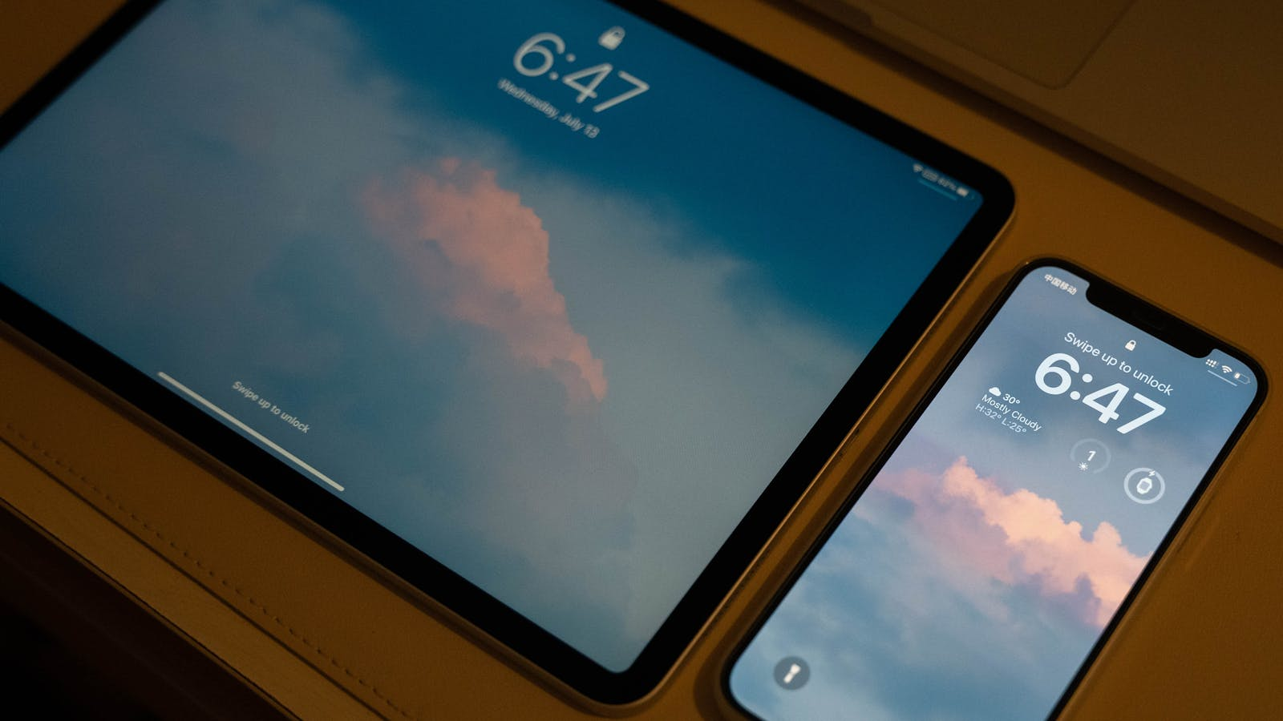
BRAMA School CyberCulture
Security and Ethics
Protection system, not mass surveillance.
Principles
• data minimization and pseudonymization;
• Human-in-the-loop;
• RBAC and action audit;
• GDPR and child-rights compliance.
What the system does not do
• does not run total surveillance;
• does not make autonomous punitive decisions;
• does not expose sensitive data without legal basis.
Menu
Back
Next
Notes:
Transition: Fade.

Slide 17

BRAMA School CyberCulture
Closing
Decision package ready for immediate controlled launch.
Partnership block
What is approved today
• Phase 1 start and control schedule;
• funding and reporting framework;
• RACI accountability for contours;
• date of first governance review.
T+7
formal launch
T+30
first review
T+90
interim KPI report
Menu
Back
Next
Notes:
Transition: Fade.

Slide 18
BRAMA School CyberCulture
Appendix Demo Overview
Deep demo contour: 5 slides, 10 cases (2 cases per slide).
Appendix structure
• A1: cases 01-02 (grooming / cyberbullying);
• A2: cases 03-04 (phishing / fake contest);
• A3: cases 05-06 (PII extraction / voice escalation);
• A4: cases 07-08 (harmful content / pseudo-recruitment);
• A5: cases 09-10 (social engineering / repeat-risk).
Menu
Back
Next
Notes:
Transition: Fade.

Slide 19
BRAMA School CyberCulture
Appendix A1
Detailed scenarios for deep demo.
01 Grooming in game chat
• Context: Unknown actor shifts a student from public chat to private channel.
• Risk: High probability of manipulation and personal data extraction.
• Flow: Guardian detects -> Officer runs SOP G-01 -> Senior validates closure.
02 Cyberbullying in school community
• Context: Coordinated insulting messages target one student.
• Risk: Psychological harm and conflict escalation.
• Flow: Signal triage -> moderation actions -> school prevention follow-up.
Menu
Back
Next
Notes:
Transition: Morph.

Slide 20
BRAMA School CyberCulture
Appendix A2
Detailed scenarios for deep demo.
03 Phishing link in messenger
• Context: Students receive fake-school login links.
• Risk: Credential compromise and spread across class channels.
• Flow: IOC detection -> account protection -> class anti-phishing micro-lesson.
04 Fake contest manipulation
• Context: Mass campaign requests child photos and contacts.
• Risk: Illicit data collection from minors.
• Flow: Wave detection -> warning package -> parent/school instruction.
Menu
Back
Next
Notes:
Transition: Morph.

Slide 21
BRAMA School CyberCulture
Appendix A3
Detailed scenarios for deep demo.
05 PII extraction attempt
• Context: Actor asks for address, phone, and document images.
• Risk: Data leakage and family-level fraud exposure.
• Flow: Sensitive marker detection -> immediate block -> family checklist.
06 Toxic escalation in voice chat
• Context: Direct verbal threats and humiliation in team session.
• Risk: Rapid conflict escalation and offline spillover.
• Flow: Evidence capture -> moderation -> controlled closure window.
Menu
Back
Next
Notes:
Transition: Morph.

Slide 22
BRAMA School CyberCulture
Appendix A4
Detailed scenarios for deep demo.
07 Harmful content spread
• Context: Students redistribute manipulative media among peers.
• Risk: Normalization of unsafe behavior patterns.
• Flow: Pattern detection -> de-prioritize spread -> corrective module.
08 Pseudo-recruitment to closed channel
• Context: Teenagers are pushed into closed anonymous groups.
• Risk: Recruitment risk and hidden coercion.
• Flow: Signal scoring -> Senior escalation -> coordinated intervention.
Menu
Back
Next
Notes:
Transition: Morph.

Slide 23
BRAMA School CyberCulture
Appendix A5
Detailed scenarios for deep demo.
09 Social engineering via known contact
• Context: Compromised friend account sends urgent requests.
• Risk: Trust-based fraud and credential theft.
• Flow: Identity check -> route quarantine -> trust-restoration guidance.
10 Repeat risk after closure
• Context: Same actor pattern appears after initial case closure.
• Risk: Recurrence due to weak follow-up controls.
• Flow: Repeat-risk protocol -> stronger controls -> extended monitoring.
Menu
Back
Notes:
Transition: Morph.

